Slide 1
Welcome
Sailors & Friends
Lake Harriet Yacht Club
Awards Banquet
2012

Slide 2


Trivia
Largest & highest participation MC Fleet in ILYA?
ILYA: 34 MC Fleets in the midwest
ILYA
Average Fleet: 15
Average Boats in a Race: 8
Races in a Season: 23
Total Boat Finishes: 204
LHYC
33
17
38
639

Slide 3
Largest & most active MC fleet in the ILYA
Highest racing participation in recent years
Die Hard the 8th largest MC regatta in 2012
2nd place at Interlakes for MC team
Expanding adaptive program
Growing youth program
Popular buoys and sought after motors
Great friends

Slide 4

TCSC
Record TCSC racing participation – 5 boats / race
Shared clinics & programs
Strong leadership
Symbiotic relationship

Slide 5
V0lunteering is at Our Core
Principal Race Officer Wendy Ott
Race Committee Chair Chris Seymour
Fall Regatta Joe Fricton
Youth Regatta Bill & Susan Kirkpatrick
Equipment Chair John Hovde
Social Chair Wendy Ott
Membership Chair Jayson Wold
Education Chair Pam Paufler
Fleet Captain MC Joe Fricton
Safety Boat Scheduler John Getsinger
Safety Boat Training Andy Crowe & Joe Fricton
TCSC Liaison Jason Curtis
Wednesday Series Kevin Berger
Dee O'Neal Cup Dave Mott
Lake Harriet's Cup Pam Paufler, John Berg
Women's Clinic Jennifer Bowers
Preseason Clinic Dave Mott and Chris Seymour
Trophy Engraving John Wentzell
Banquet Jim Marquardt
Website Jennifer O'Brien, Paul Baltzersen, Jason Curtis
Fleet Captain M-16 Ted Jewett & Jack Zimmerschied
Score Keeper Andy Crowe & Steve Loscheider
Yearbook Wendy and Chuck Ott
Adaptive Sailing Karen Hemstad, Ted Jewett, Andy Crowe
Photo Trophy Coordinator Joe Friction
Park Board Liaison Paul Baltzersen
Delegate to the ILYA Joe Fricton
Display Cases Wendy Ott
Logo Gear Procurer John Wentzell
Commodore Robert Netzer
Vice Commodore Joe Fricton
Rear Commodore Dave Mott
Secretary Charlie Gantzer
Treasurer Chuck Ott
Director Jennifer O'Brien
Director Pam Paufler
Director Jason Curtis
Director Bob Dillon
TCSC Rep Kraig Larson
TCSC Racing John Berg

Slide 6
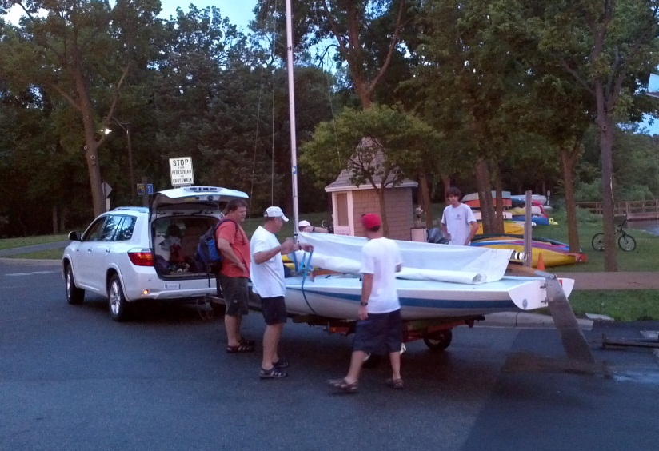
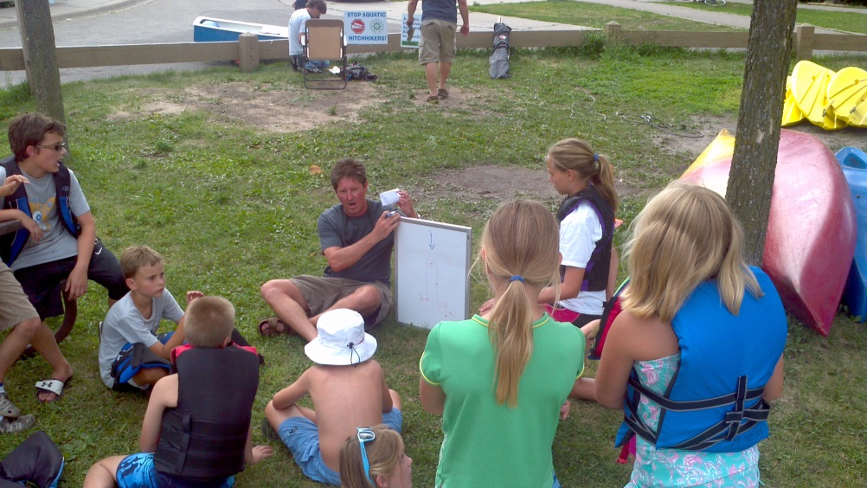
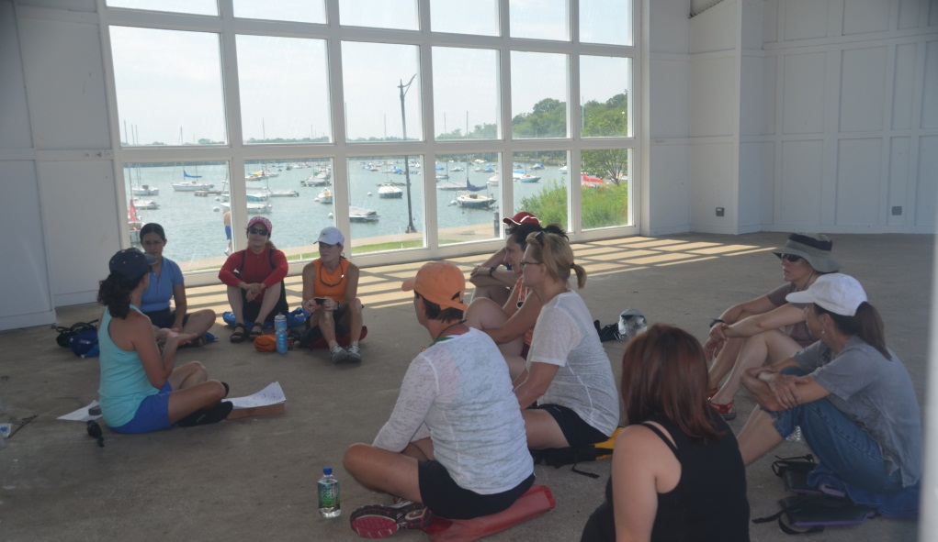
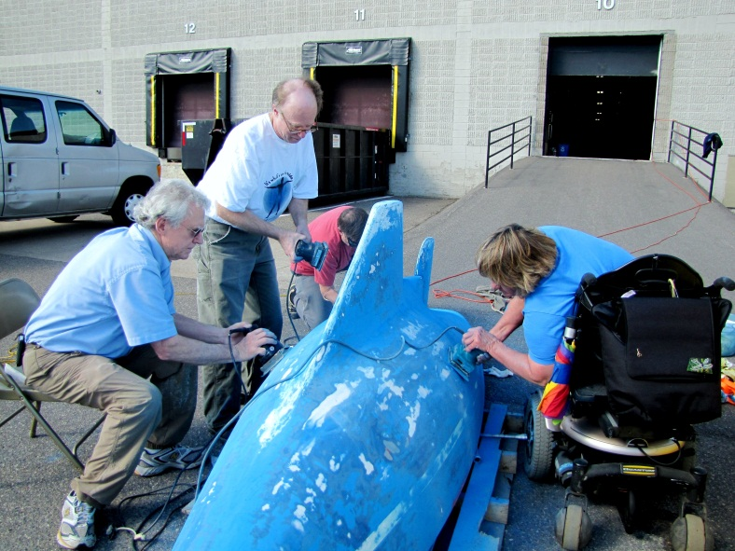
Club Culture

Slide 7
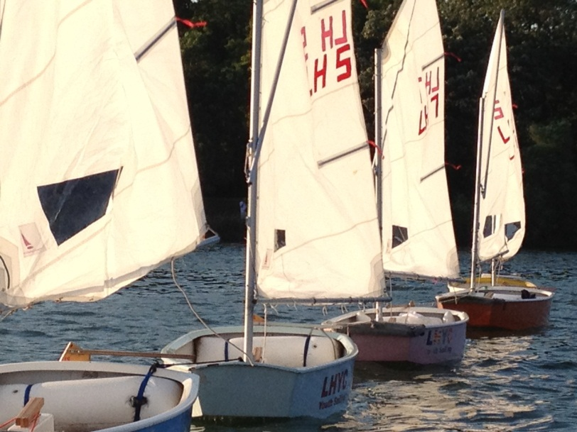
LHYC Youth Program
Bill Kirkpatrick

Slide 8
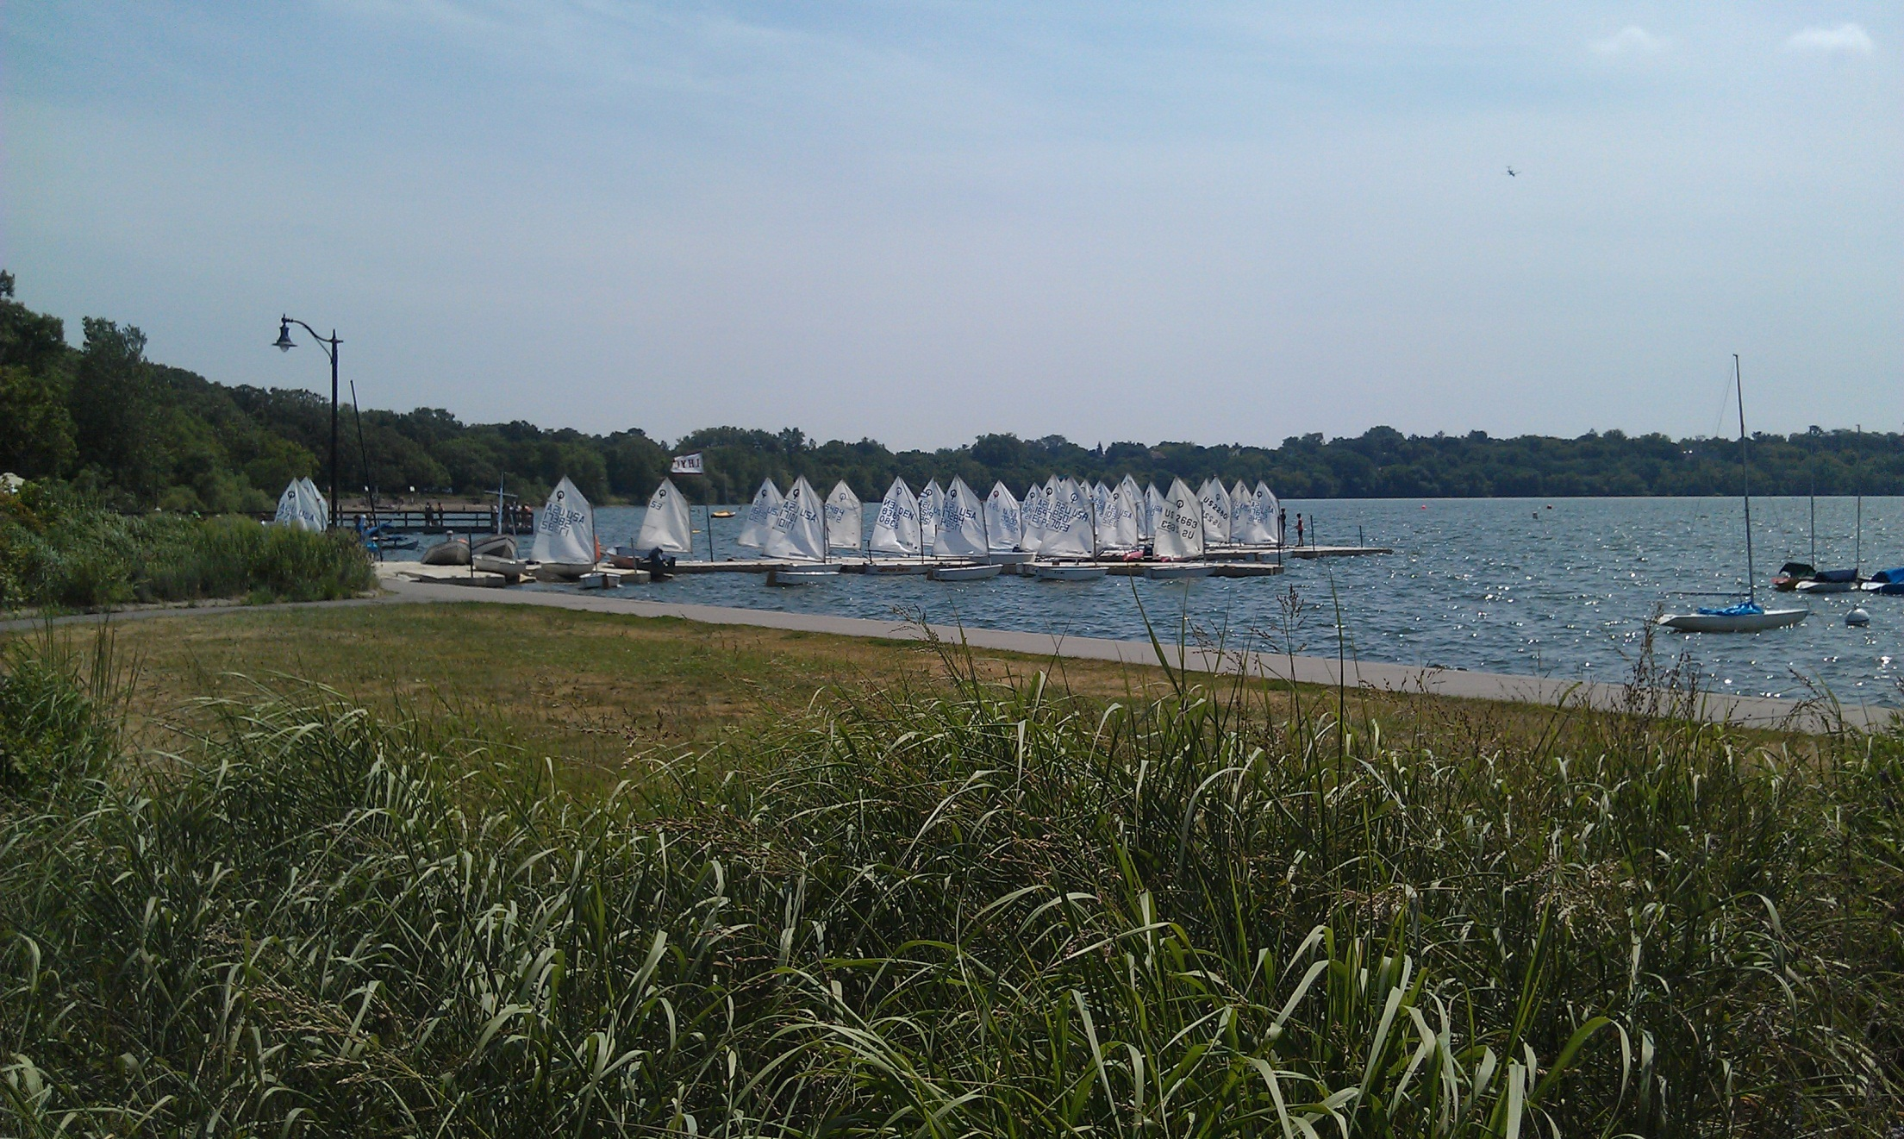
TCYS Ribbon
The Twin Cities Youth Sailing (TCYS) program hosts youth racing most Fridays through the summer, rotating among Calhoun Yacht Club, Minnetonka YC, St. Croix Sailing Club, Wayzata YC, Lake Harriet YC and White Bear YC
Congratulations to:
Maeve Katics

Slide 9
Recognition
Congratulations to:
All Youth Sailors

Slide 10
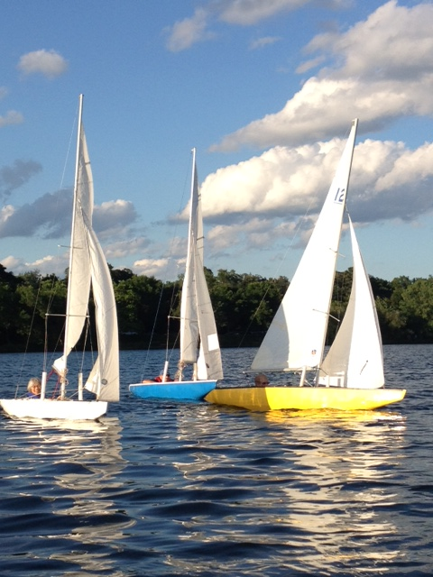
LHYC Adaptive Program
Karen Hemstad

Slide 11
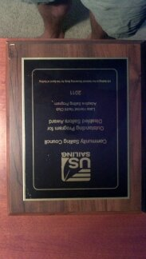
LHYC Adaptive Program
US Sailing
Community Sailing Council
National Award
Outstanding Program for Disabled Sailors

Slide 12
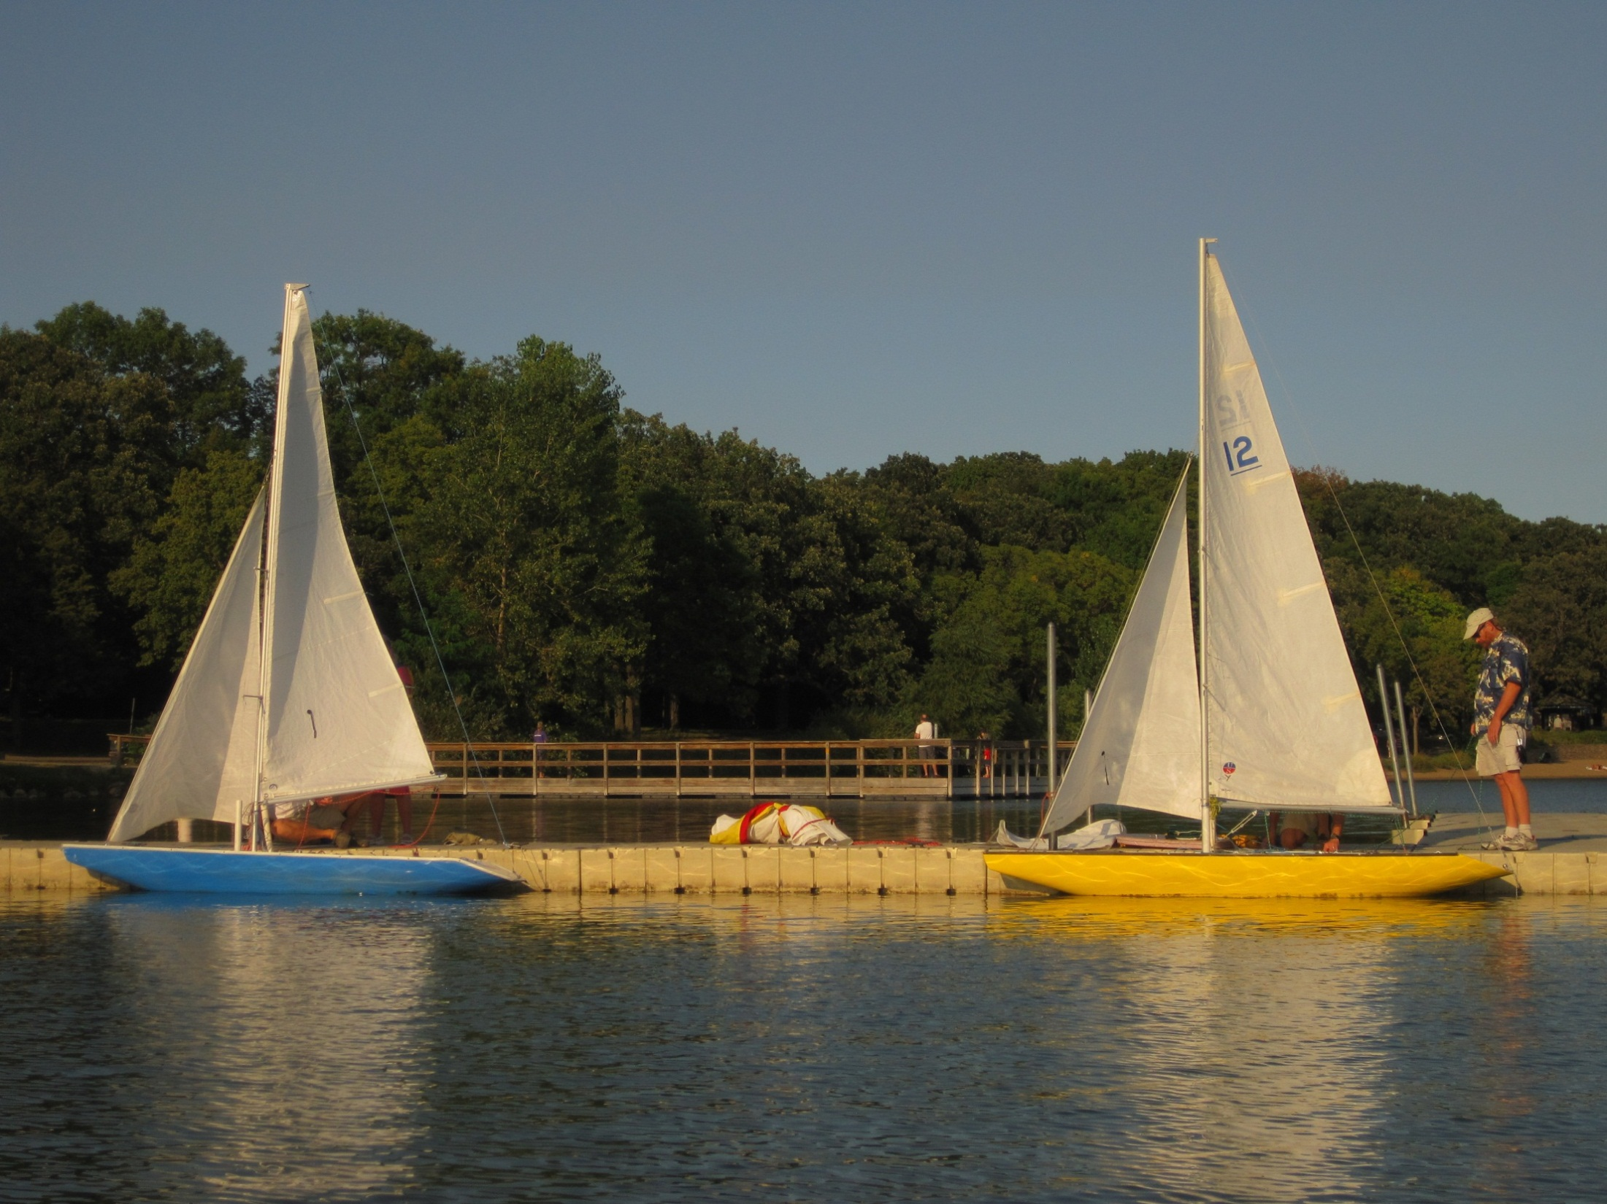
Most Improved Adaptive
Most improved sailing skills for an Adaptive sailor as demonstrated throughout the season
Congratulations to:
Sue Fink

Slide 13
Midshipman Award
Awarded to Sailor who demonstrates consistent selflessness throughout the sailing season on and off the water
Congratulations to:
Paul Van Winkle

Slide 14
Top Volunteer
Awarded to individual who demonstrates consistent altruism throughout the season to improve: boats, training, and most importantly, the spirit of the Adaptive Sailing Club
Congratulations to:
Lori Wheatcroft

Slide 15
Club History
How much were membership dues in 1941?
$1
What were the club’s assets?
$28.97
38 members
Classes C Scow & X Scow
First race was on Sunday morning July 6th, 1941
1991 Yearbook, Dolores Pospesel
Notes:
Should have had $38…
Spent the money on a candy for a treasure hunt, post cards and stamps,..
…and watermellons.
Thank you dolores for the research!

Slide 16
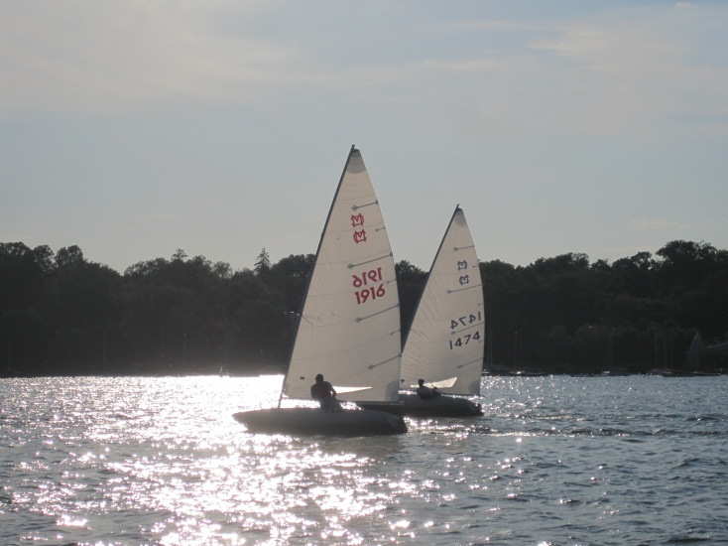
Racing Awards
Notes:
Invite Joe Schroeder, Dave Mott, Bill Kirkpatrick, Jim Marquardt
Joe may need extra hands
Ask to line up left to right
Ask them to stay up front

Slide 17
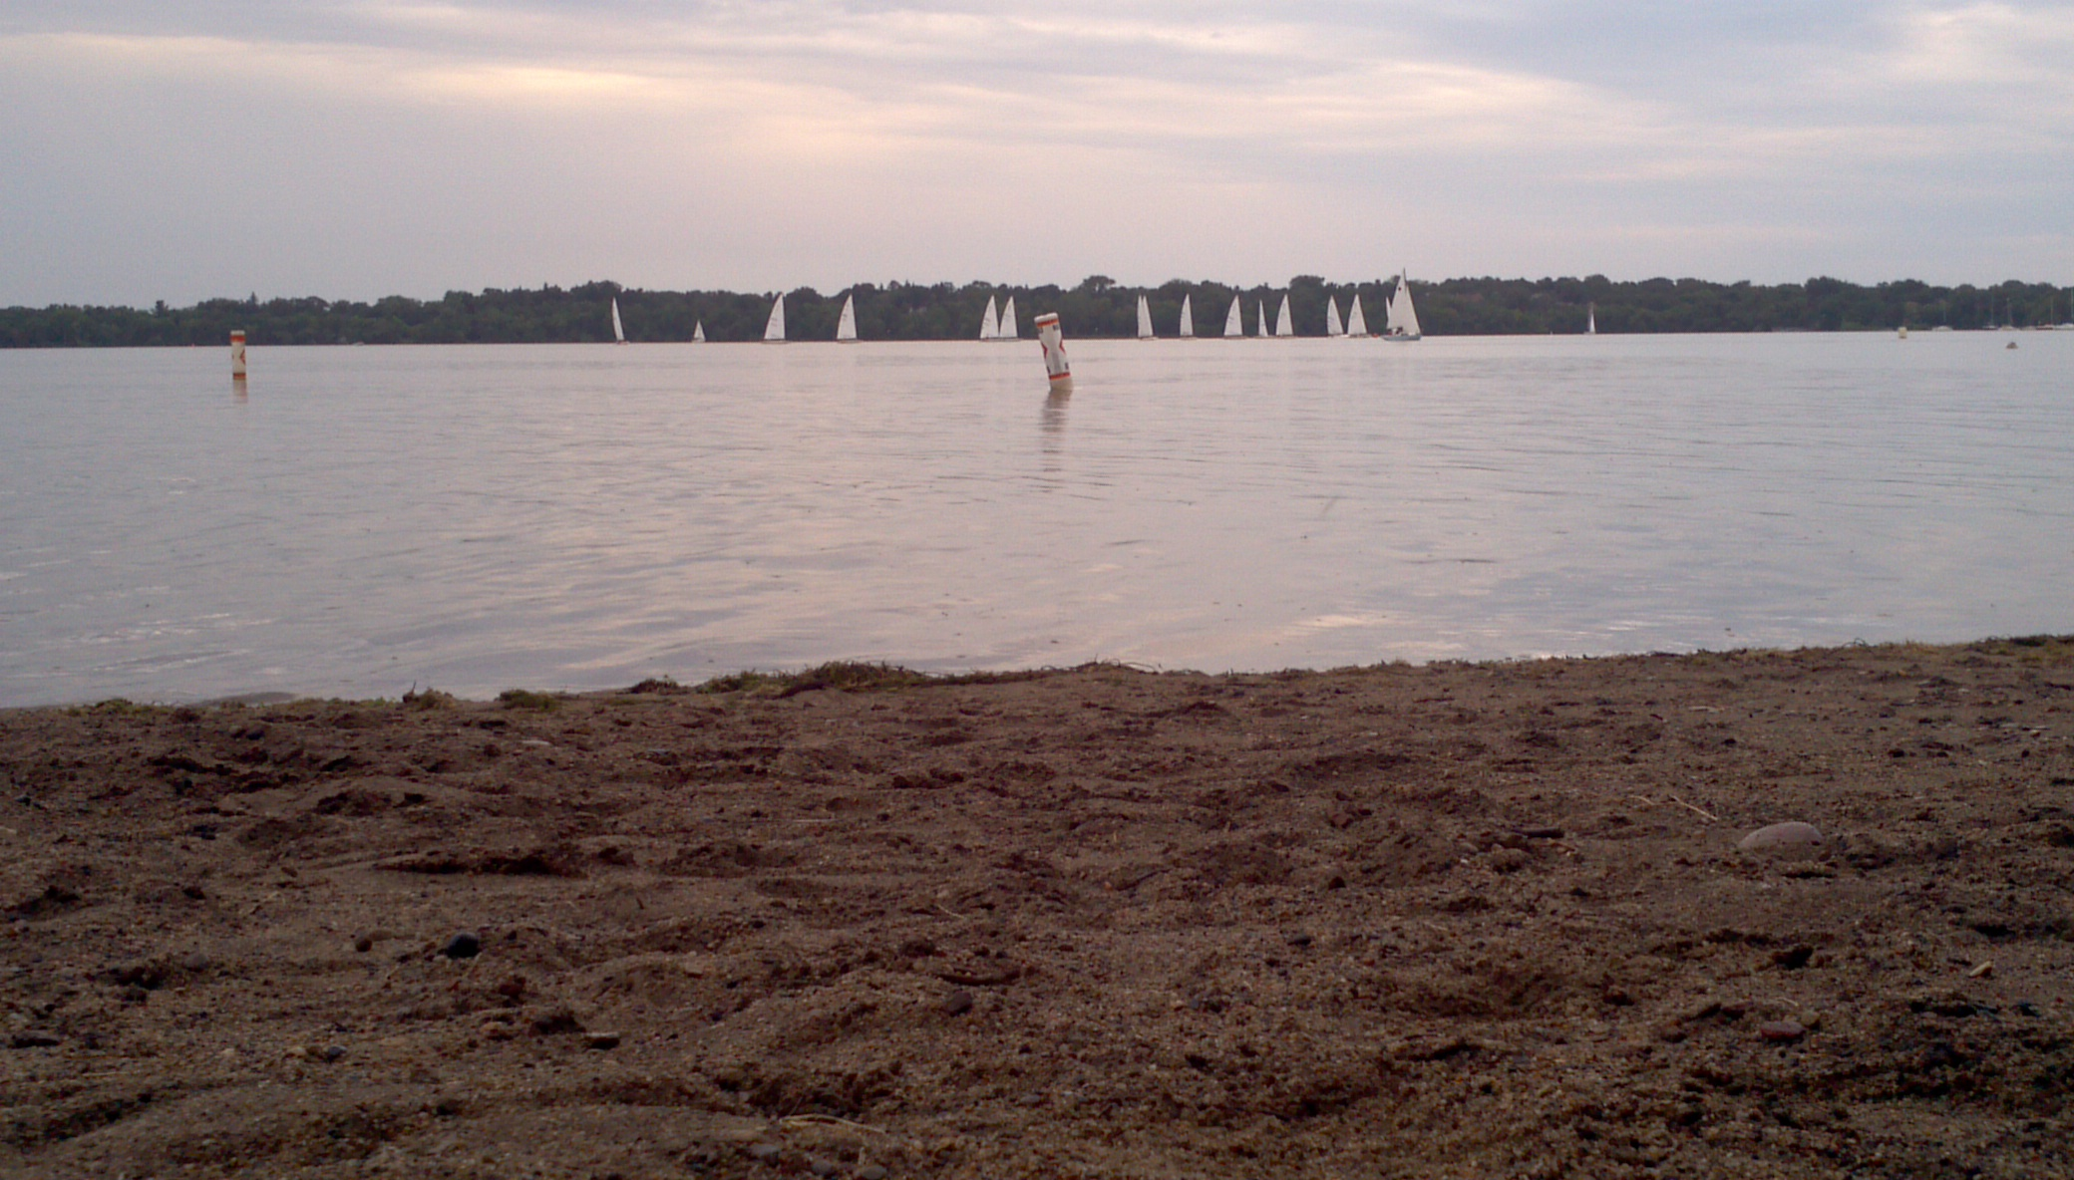
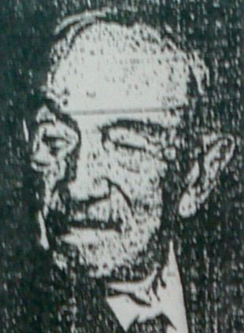
Isaac Reeve Memorial
M16 Scow
Isaac Reeve Series, May to mid-June
Named to honor of his father, General Charles Reeve (1847-1947), who was active member in the Minnetonka Yacht Club and also had the first sailboat on Lake Harriet.
Congratulations to:
Joe Schroeder

Slide 18
Isaac Reeve Memorial
MC Scow
Isaac Reeve Series, May to mid-June
Named to honor of his father, General Charles Reeve (1847-1947), who was active member in the Minnetonka Yacht Club and also had the first sailboat on Lake Harriet.
Congratulations to:
Dave Mott & Bill Kirkpatrick

Slide 19
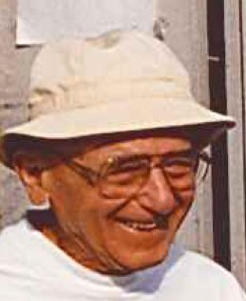
Peter Super Memorial
M16 Scow
Peter Super Series, mid-June to July
Peter Super was a member of LHYC for 39 years. He sailed a D, a C and an M16, and served on the race Committee in 1967. For 26 years he managed the shed and club equipment from 1965-1991.
A kind, gentle, and caring man, Peter was friend to sailors for 4 decades. Peter died in 2000 at age 90.
Congratulations to:
Joe Schroeder
Notes:
Reference John Hovde and 26 years of shed & equipment maintenance

Slide 20
Peter Super Memorial
MC Scow
Peter Super Series, mid-June to July
Peter Super was a member of LHYC for 39 years. He sailed a D, a C and an M16, and served on the race Committee in 1967. For 26 years he managed the shed and club equipment from 1965-1991.
A kind, gentle, and caring man, Peter was friend to sailors for 4 decades. Peter died in 2000 at age 90.
Congratulations to:
Dave Mott & Bill Kirkpatrick

Slide 21
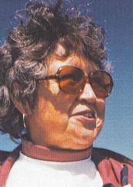
Dorothy Schepers Memorial
M16 Scow
Dorothy Schepers Series, August
Dorothy and Jim first joined LHYC in1971 with a C boat, an X boat and an MC for their family.
Dorothy went on to become the 1st Female Head Judge, and later on 1st Female Commodore in 1979.
Congratulations to:
Joe Schroeder

Slide 22
Dorothy Schepers Memorial
MC Scow
Dorothy Schepers Series, August
Dorothy and Jim first joined LHYC in1971 with a C boat, an X boat and an MC for their family.
Dorothy went on to become the 1st Female Head Judge, and later on 1st Female Commodore in 1979.
Congratulations to:
Jim Marquardt
Notes:
Jim had an impressive 2 bullets and 3 2nd place finishes

Slide 23
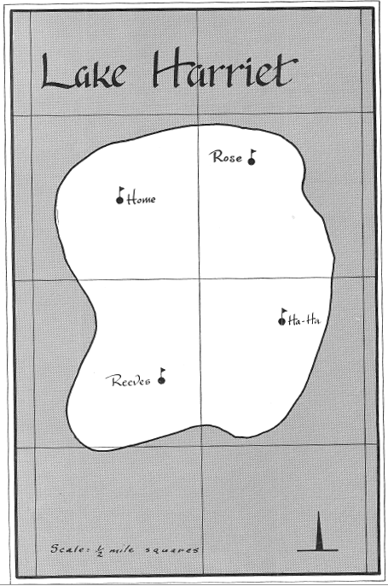
Trivia
What are the names of the 4 permanent buoys?
1960 ILYA yearbook
Notes:
First to raise hand and answer all correctly wins a prize
Home, Rose, Reeves, Ha-Ha. Reeve owned the property at the south shore of the lake.
Emma Hand out prize – can buy for $10 from the city.
Read quote from yearbook on lack of buoys.

Slide 24
Commodore’s Cup
M16 Scow
Winner of the Commodore’s Cup
The Commodore holds a race day after the normal racing season is over. Commodore designs a course and officiates the races. The cup is awarded to the fastest sailor on race day.
Congratulations to:
Ted Jewett
Notes:
Call up Dave Mott, Bill Kirkpatrick, Madeline Netzer (for Andy Crowe), John Katics, John Getsinger, and Frazer Heinis
Ask to line up left to right
Ask them to stay up front

Slide 25
Commodore’s Cup
MC Scow
Winner of the Commodore’s Cup
The Commodore holds a race day after the normal racing season is over. Commodore designs a course and officiates the races. The cup is awarded to the fastest sailor on race day.
Congratulations to:
Dave Mott & Bill Kirkpatrick
Notes:
Call up Dave Mott, Bill Kirkpatrick, Madeline Netzer (for Andy Crowe), John Katics, John Getsinger, and Frazer Heinis
Ask to line up left to right
Ask them to stay up front

Slide 26
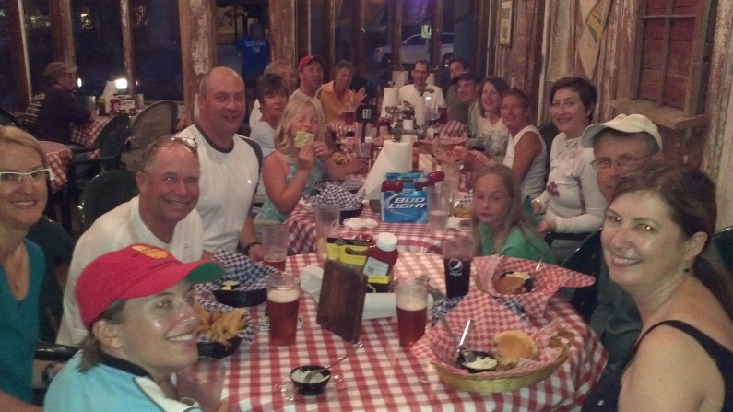
Wednesday Evening Series
Winner of the Race Series
Wednesday night racing is marked by lots of short-course races, crowded starts & mark roundings, and a great recap at Famous Dave’s in Linden Hills.
Congratulations to:
Andy Crowe
Notes:
Madeline Netzer

Slide 27
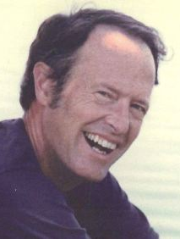
Pete Taylor Memorial
Best Light Air MC Sailor
Commodore in 1985, Peter was a devoted member of LHYC from ~1950 until passing in 2008. He developed an uncanny ability to thrive in “light air,” provoking frustration and admiration from many of his competitors. A Honeywell design engineer for most of his life, he took up family law at age 65.
Congratulations to:
John Katics & John Getsinger

Slide 28
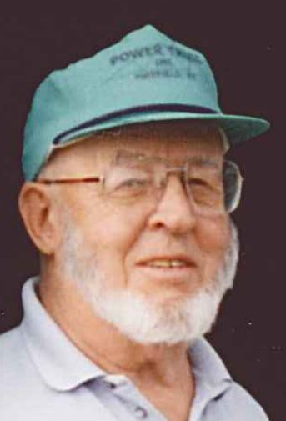
Dee O’Neal Memorial
Novice Skipper Award
Formerly the Westrum’s Cup, the award is given to the novice sailor who skippered the fastest boat on the single night of the Wednesday evening race series in honor of Dee O’Neal.
Congratulations to:
Frazer Heinis

Slide 29
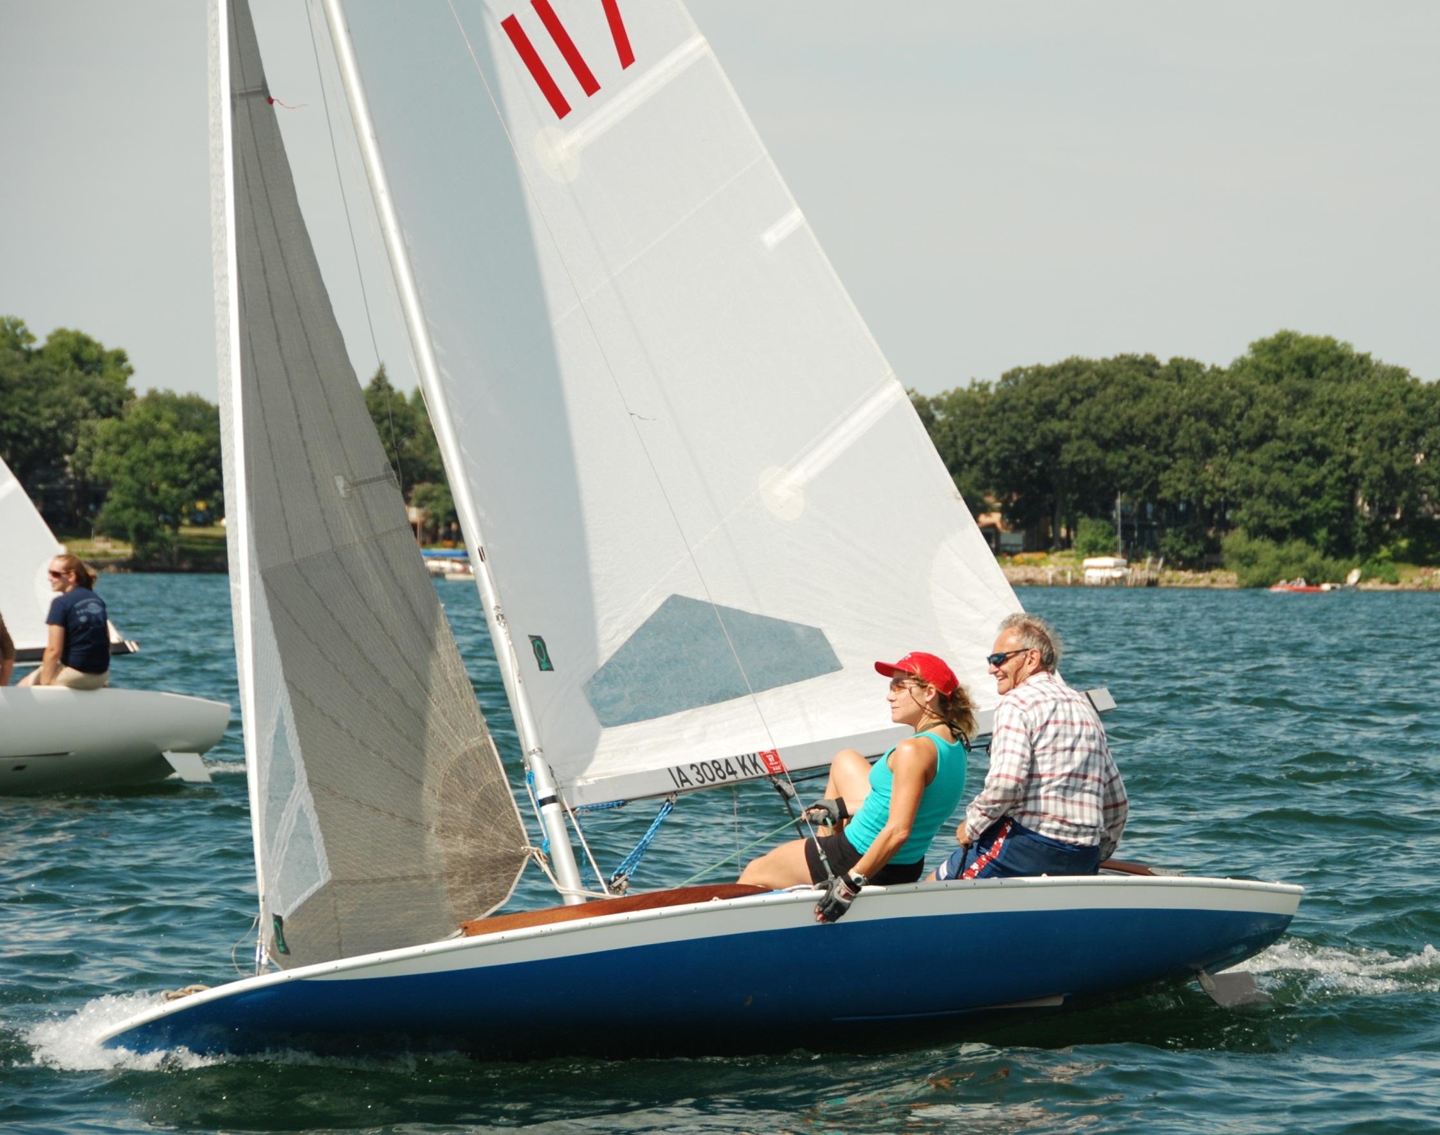
Honorary LHYC Membership
Jack Zimmerschied
Notes:
Invite John Barbour to speak

Slide 30
Club History
What year did LHYC have its largest racing fleet?
1968
88 boats in 4 classes
Year D C X M MC Total
1951 14 16 30
1960 18 18 26 62
1968 3 36 32 17 88
1970 28 18 15 59
1980 10 5 16 15 46
1990 6 7 26 11 50
2000 11 31 42
2012 5 33 38
Next new fleets? Illusion mini-12? Optimist? 420?
source: 1991, 2000 yearbooks, 2012 racing stats

Slide 31
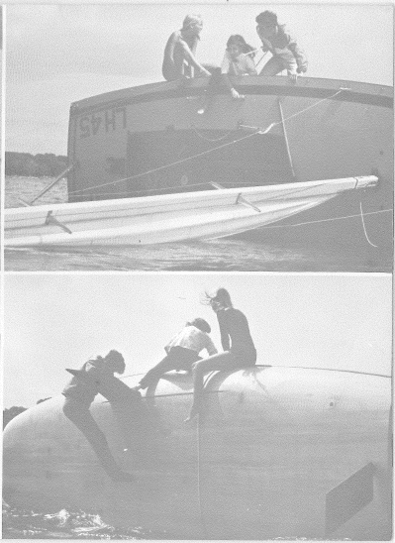
How to build a successful club?
1967
Notes:
Forget optis, just put the kids on C Scows and do capsize drills

Slide 32
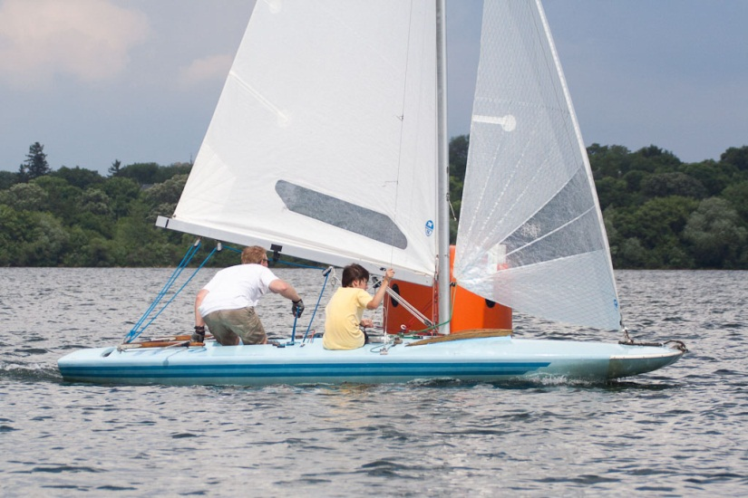
M Holiday Series
John Barbour & Wally Daniels
Joe Schroeder
Ted Jewett
Notes:
Ted Jewett, Joe Schroeder, John Barbour & Wally Daniels

Slide 33
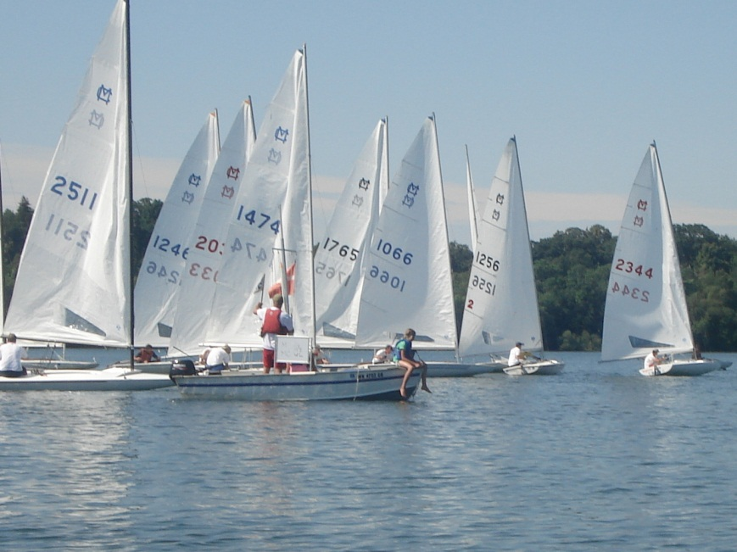
MC Holiday Series
Bill Colburn
Andy Crowe & Robert Netzer
Chris Seymour
John Katics & John Getsinger
Jennifer Bowers & Pam Paufler
Notes:
Jennifer Bowers, Paul Paufler, John Katics, John Getsinger, Chris Seymour, Madeline Netzer, Bill Colburn

Slide 34
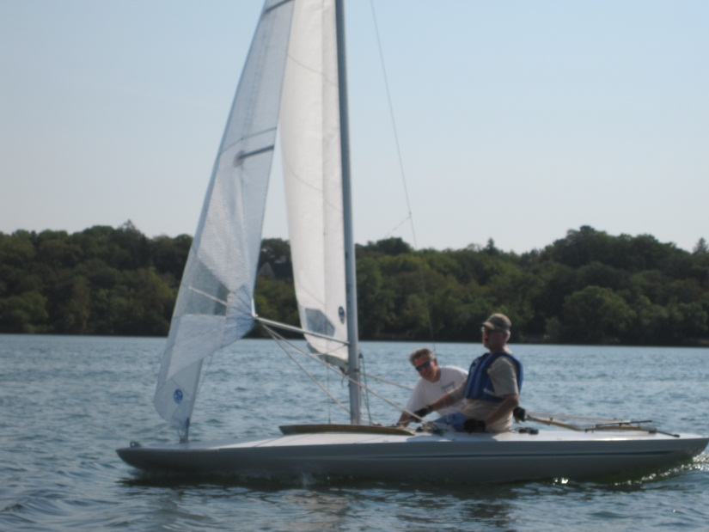
M Season Championship
Joe Schroeder
John Barbour & Wally Daniels
Ted Jewett
Paul Bastyr & Jennifer O’Brien
John Wentzell
Notes:
Joe Schroeder, John Barbour & Wally Daniels, Ted Jewett, Paul Bastyr & Jennifer O’Brien, John Wentzell

Slide 35
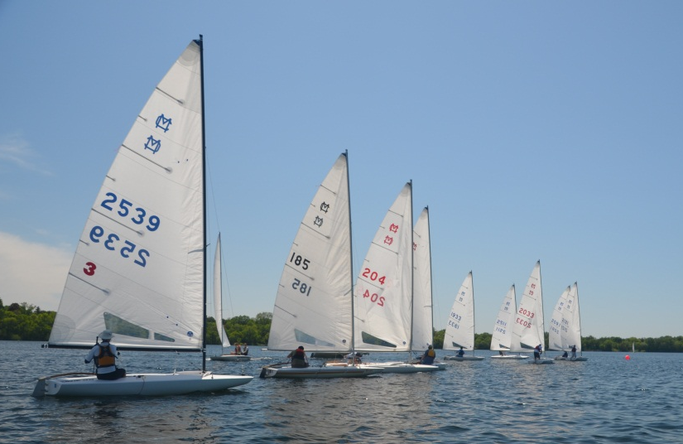
MC Season Championship
Dave Mott & Bill Kirkpatrick
Bill Colburn
Andy Crowe & Robert Netzer
John Katics & John Getsinger
Joe Fricton & Gary Reiter
Chris Seymour
Jim Marquardt
Notes:
Jim Marquardt, Chris Seymour…

Slide 36
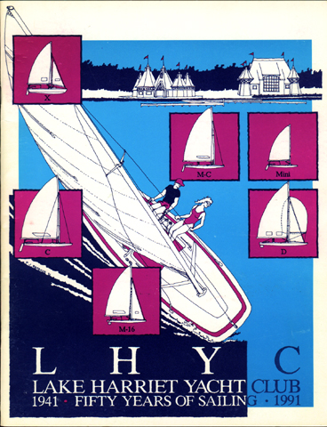
Special Awards
Notes:
Invite Pam Paufler, Jennifer Bowers, Wally Daniels, Paul Baltzersen

Slide 37
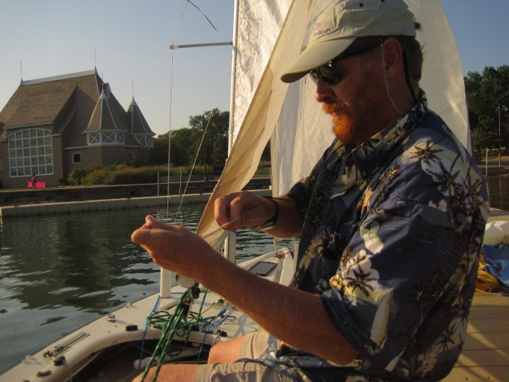
Lynn Jorgensen Award
Race Management
Lynn joined us 1996 through the U of M Sailing Club and has remained active as an all-round contributor. Having assisted in so many judges’ boats, Lynn has developed an appreciation of the benefits and the need for superior skills in this arena.
Congratulations to:
Wally Daniels
Notes:
PRO from 2003 or 2004 until 2010
Contributed to race officer training materials & guidelines
Trained many of our newest race officers, continues to guide our team.

Slide 38
Women’s Challenge
Outstanding Female Skipper
Outstanding female skipper of the year, who has scored the highest for the season both on and off the lake.
Congratulations to:
Pam Paufler & Jennifer Bowers

Slide 39
Spirit Award
LHYC Spirit Award
Best promoter of LHYC within the club and in the community
Congratulations to:
Paul Baltzersen
Notes:
Key in maintaining such an important place for us for keeping organized, seeing our racing results, schedules, web cam, and new this year the weather station.
Paul for many years of construction & support of our web site

Slide 40
New LHYC Web Site!
Notes:
Emma & Madeline to hold ribbon.
Jason Curtis and Jennifer O’Brien to cut ribbon.

Slide 41
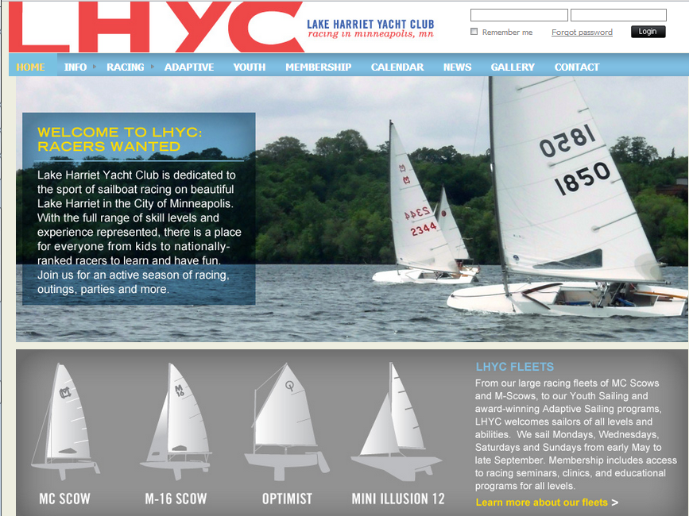
Notes:
Current webs site has served us very well.
Goals – separate into members-only info and how to greet new members.
Add functionality – online membership application, event registration, Commodore
blogs integrated with calendar.
New technology
Make running the club smoother.

Slide 42
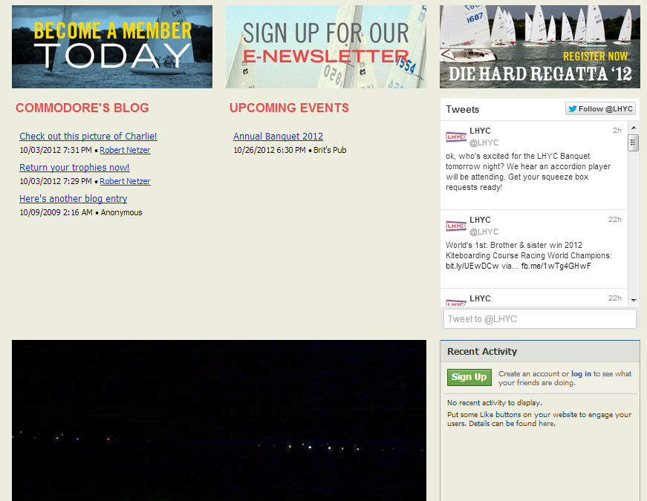
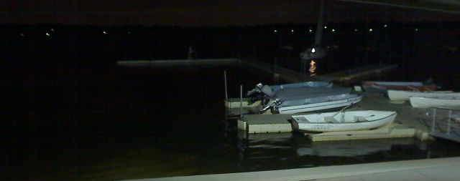

Slide 43
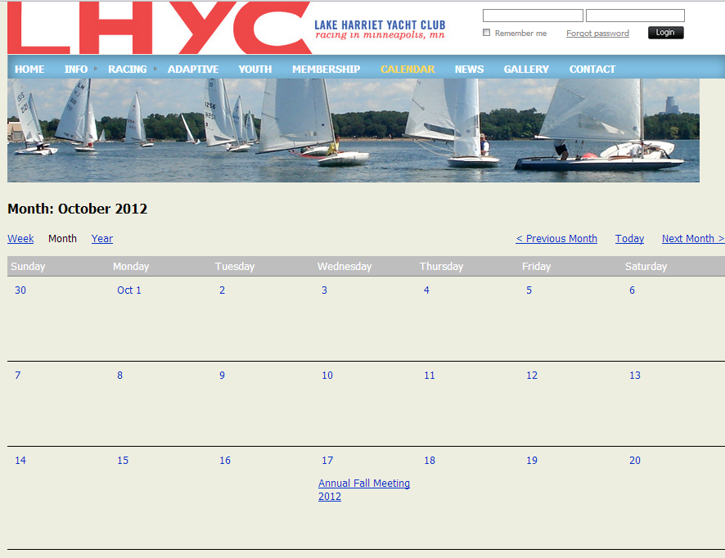

Slide 44
Special Awards Continued
Notes:
Invite Wally Daniels, John Barbour, Jamie Fraser, and Bill Kirkpatrick

Slide 45
US Yacht Racing Union
Sportsmanship
Consistent good sportsmanship on and off the water
Congratulations to:
Bill Kirkpatrick
Notes:
Sportsmanship = not just fairness of play, but fostering enthusiasm for the sport
Bill Kirkpatrick for the Youth Program
Grass roots effort to create a youth program.
Obtained 8 Optimists,
Had a rack built
2x 420s & floating lift
Helps with TCYS (Twin Cities Youth Sailing) regatta
Created an environment where kids can gain confidence on the water and have fun sailing.
Parents and children can share experiences together – rare in today’s world of organized kids sports.
Sailing as witnessed by those in the room is truly a lifetime sport.

Slide 46
Most Improved M16
Most improved M skipper & crew of the year
Congratulations to:
John Barbour & Wally Daniels

Slide 47
Most Improved MC
Most improved MC skipper of the year
Congratulations to:
Jamie Fraser
Notes:
Significant improvement from last year in champ & holiday series
1st champ win, 1st TCSC champ win
and had the most weekend starts of any individual skipper on the lake

Slide 48
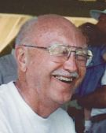
Al Fleming Memorial
Committed Volunteerism, Crew/Social Member
Al and his wife Liz joined LHYC in 1972. Al was Commodore in 1987. Together they inspired sailors of all ages to sail every race, for the sheer joy of sailing, being with friends, and exchanging wonderful tales of lake lore at every party.
Congratulations to:
Lynn Jorgenson
Notes:
Recognize Liz Fleming
Excellent race officiating support, volunteering at the lake, adaptive sailing volunteering, and all-around champion for our club

Slide 49

Dick Adams Memorial
Most Devoted Sailor
Dick was a long time devoted sailor in the ‘60’s and ‘70’s. In 1983, his wife Marcie donated this trophy in his honor to celebrate those who stood out in “dedication, good competition, striving for improvement, helpfulness to others, and friendship”
Congratulations to:
Bill Hanson
Notes:
Commodore 1986
Director 1984, 1985
Labor Day Picnic 2001
MC Fleet Captain - 1987
Park Board Liason 1991, 96
Trophies 1980
Spring Regatta 1981, 93, C Tri-Lake Regatta 1982
LHYC Club Song - 1988
Race Committee, Race Officer 1987, 1992, 93, 94, 01, 92, 95, 99, 00 and beyond… + regattas in 2000’s
Continues to hone skills, gone through certification as a Club Judge by US Sailing

Slide 50
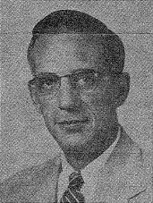
Marshman Wattson Memorial
Best Sailor On and Off the Lake
Marsh Wattson was Commodore in 1960, and died in 1962. In his lifetime, he taught law at U of M and Wm Mitchell. He was a prominent leader of the MN Civil Liberties Union (MCLU) and the First Unitarian Society.
Congratulations to:
Bill Colburn
Notes:
2nd place Champ Series
1st place Holiday Series
5th place ILYA Championships
4th place Die Hard
2nd place team Interlakes
1st place individual Interlakes
1st place ILYA Invitational
2nd place MCSA National Championships
– with 94 boats, many were prior regatta winners
- 7 prior national champs racing
- also won a race at nationals

Slide 51
Rear Commodore Award
Congratulations to:
Robert Netzer

Slide 52
Banquet Volunteers
Brit’s Pub & Live Music - Jim Marquardt
Trophy Engraving - John Wentzell
Picture Trophies - Joe Fricton, Bill Colburn, Dave Mott, John Hovde
Honorary Trophy - Dave Mott
Yearbook –Wendy & Chuck Ott
Artwork - Nancy Grist-Franchett
Photos & Video – Many Contributers

Slide 53
Looking Forward to 2013
Commodore – Joe Fricton
Vice Commodore – Mark Anderson
Rear Commodore – Robert Netzer
Secretary - Charlie Gantzer
Treasurer - Chuck Ott
Returning Director – Jason Curtis – Education Chair
Returning Director – Pam Paufler
1st Year Director - Kevin Berger
1st Year Director – Joe Schroeder

Slide 54
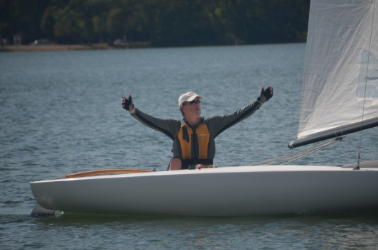
Marshman Wattson Memorial
“I can’t believe it’s over”
Best Sailor On and Off the Lake
Marsh Wattson was Commodore in 1960, and died in 1962. In his lifetime, he taught law at U of M and Wm Mitchell. He was a prominent leader of the MN Civil Liberties Union (MCLU) and the First Unitarian Society.
Congratulations to:
Bill Colburn
the bar is still open

