Slide 1
Lake Harriet Yacht Club Annual Banquet 2013
A look into the past and present of LHYC

Slide 2
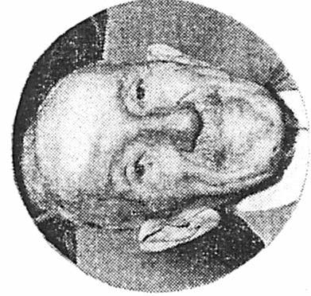
LHYC HistorY The Start of the Club
The first sailboat was sailed on Lake Harriet in 1871 by General Charles McC Reeves. The boat’s name was Oriole.
Prior to 1940, sailboats were not allowed on Lake Harriet, only canoes.
The Lake Harriet Yacht Club was formed in 1941, after the demand for buoys on Lake Calhoun became too great, and the park board allowed sailboats on Lake Harriet.
Charles Reeves was made the first honorary member of LHYC in 1943 on his 95th birthday. Mr. Reeves was so thankful that he donated several silver bowls to be awarded as trophies and did so on behalf of his father Isaac Reeves.
Trivia: Where did LHYC hold its FIRST awards banquet in 1941?
THEODORE WIRTH CHALET

Slide 3
LHYC Youth Program Robert Netzer

Slide 4
LHYC Youth Program Participants
Spencer Devens
Adele Fraser
Mickey Fraser
Maeve Katics
Ellen Kirkpatrick
Lucy Lamosse
Calvin Lamosse
Emma Netzer
Madeline Netzer
Annalynne Prochaska
Keelan Samson-Garry
Petra Samson-Garry
Mitchell Schroeder
Helene Schroeder
Carmen Mattingly

Slide 5
LHYC Adaptive Sailing Program Karen Hemstad

Slide 6
Adaptive Program Participants
Most Improved-Brian Foster
Midshipmen-Terry Hanson
Top Volunteer-Lynn Jorgenson
Participants:
Paul VanWinkel
Sue Fink
Terry Hanson
Lynda Petersen
Tom Cronmiller
Billy Golfus
Brian Foster

Slide 7
LHYC HISTORY A Family and All-inclusive Affair
According to a June 28, 1942 article in the Minneapolis Tribune early LHYC members had the following goals:
The idea of LHYC was for people interested in sailing “to have a project to be enjoyed by every member of the family.”
“Children, the college group, and parents all race together.”
“There is virtually no age limit for sailors and the humblest equipped boat on the lake has as much chance as the grandest.”
Family Activities:
Watermelon Races
Club Open Houses and Parties
Parent-Child Races
Member Boat Swap Races

Slide 8
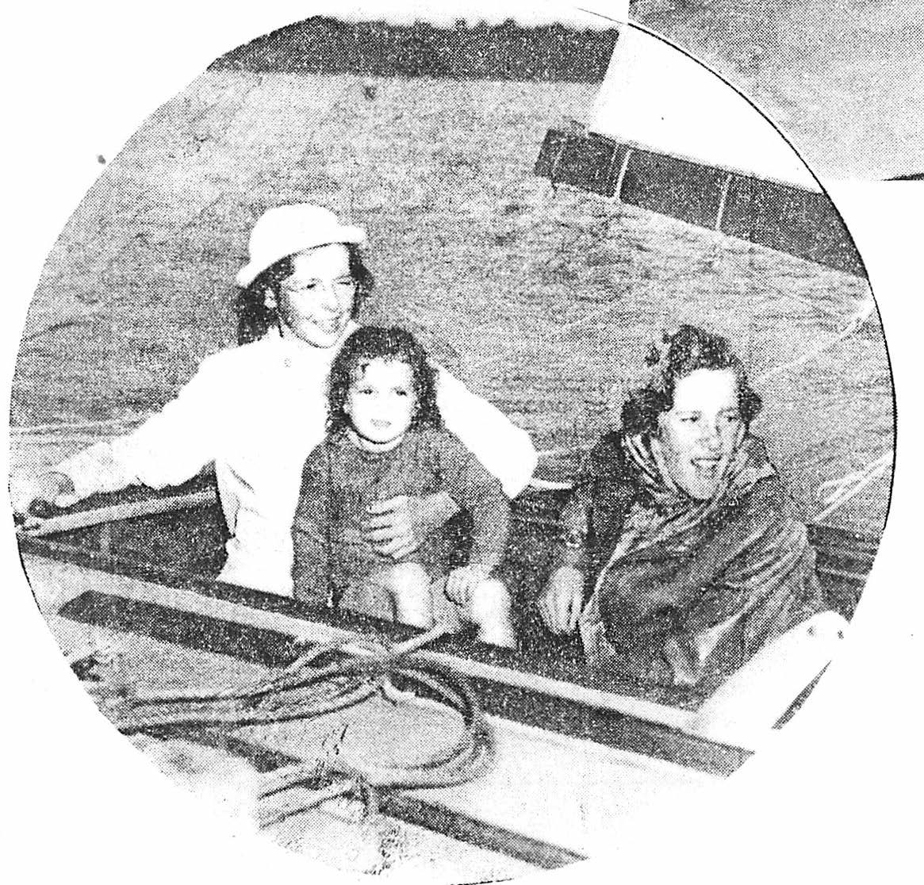
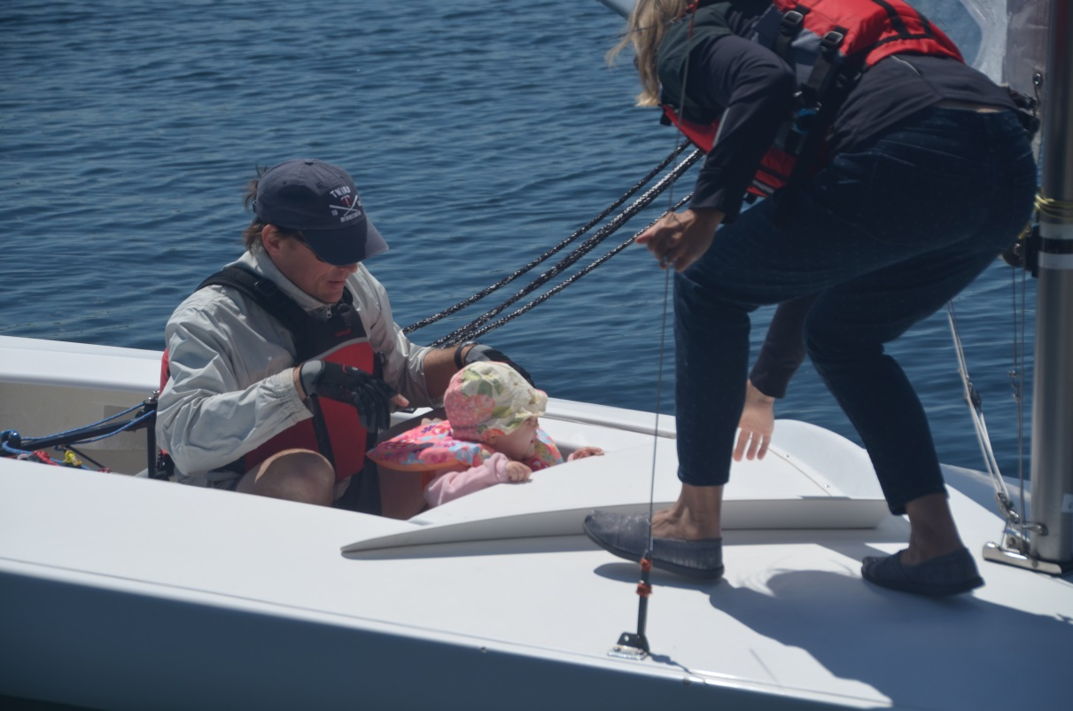
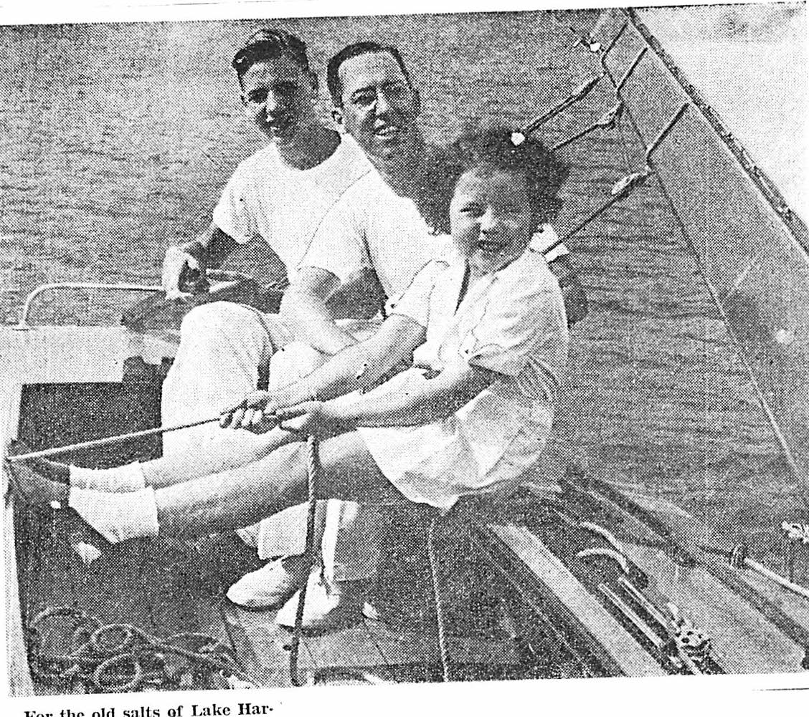
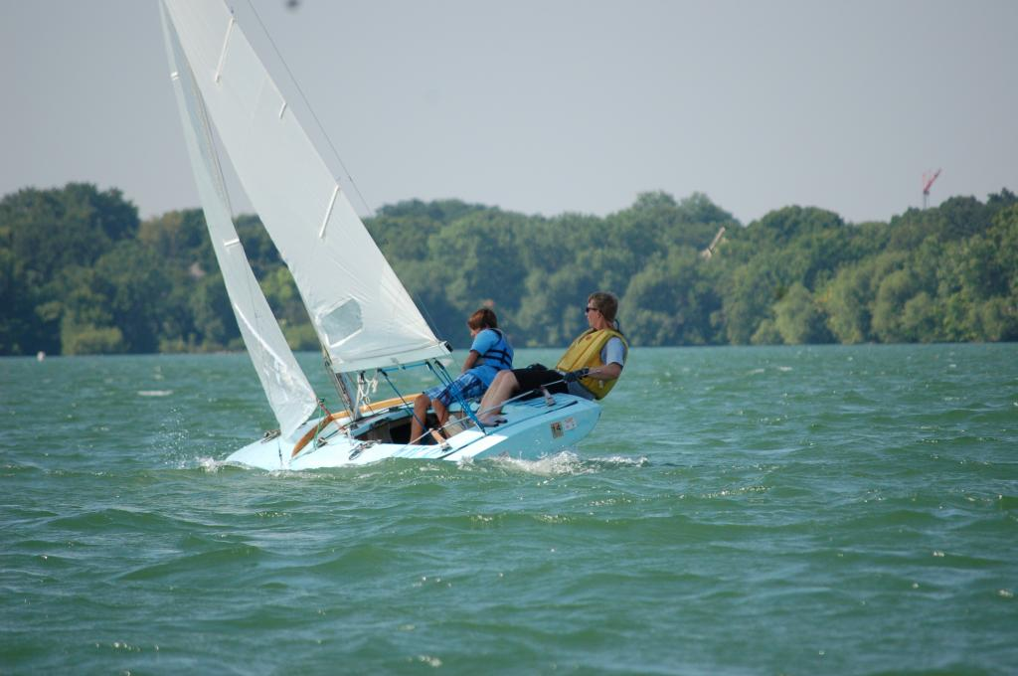

Slide 9
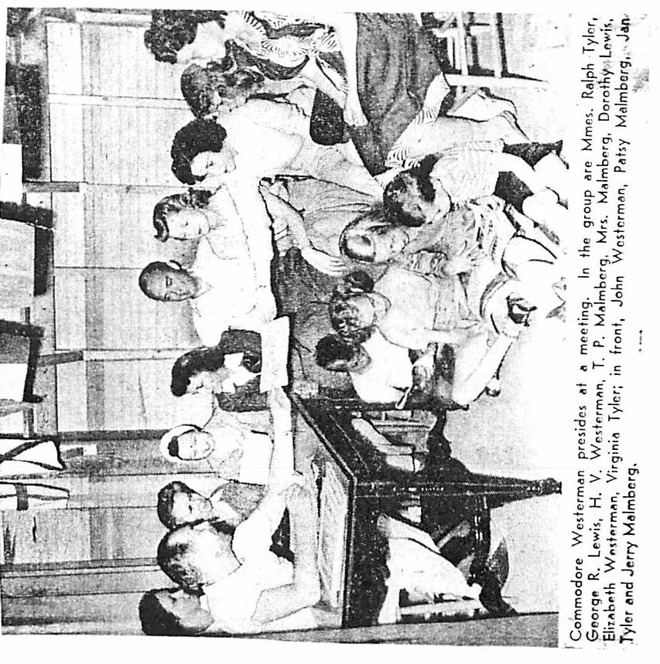

Slide 10
Racing Awards

Slide 11
Isaac ReeveS Memorial M16 Scow MC Scow
Isaac Reeves Series: May though mid-June
Congratulations:
Attack: John Barbour and Wally Daniels
Tangerine: Bill and Maureen Colburn

Slide 12
Peter Super Memorial M16 Scow MC Scow
Peter Super Series: mid-June though July
Congratulations:
Attack: John Barbour and Wally Daniels
Humdinger: Jason Curtis

Slide 13
Dorothy Schepers Memorial M16 Scow MC Scow
Dorothy Schepers Memorial Series: August
Congratulations:
Attack: John Barbour and Wally Daniels
Little Fish: John Hovde

Slide 14
Commodore’s Cup Team Racing
Congratulations:
Commodore 9: Ted Jewett and David Saltzman
American Flyer: Robert and Maddy Netzer
MC 2539: Charlie Gantzer

Slide 15
Pete taylor Memorial Best Light Wind MC sailor
Congratulations:
MC 2121: Dave Mott and Jackie Melgard
Bill Kirkpatrick

Slide 16
Dee o’Neal Memorial Novice Skipper Award
Congratulations:
TCSC: Eric McDermott

Slide 17
Jim & Dorothy Schepers Memorial Handicap Racing Series
Congratulations:
TCSC: Jerry Tennis

Slide 18
Wednesday Night Series
Congratulations:
American Flyer: Andy Crowe

Slide 19
LHYC HISTORY Challenges in building the club
According to a 1943 Minneapolis Tribune article, the top three reason for this scarcity of boats:
Because of rationing during World War 2, boat builders, by government orders, were not able to build boats after 1941.
Many boat owners and skippers who went to war did not sell their boats, “wanting a good boat to race” when they return.
Many people turned to “sailing because of gas rationing.”
In the 1940s, one of LHYC’s biggest challenges was finding boats.
What event made it difficult for LHYC to obtain boats in the 1940s?
World War 2

Slide 20
MC COMbined Holiday Series
1st Tangerine: Bill and Maureen Colburn
2nd Gryffin: John and Maeve Katics and John Getsinger
3rd American Flyer: Andy Crowe and Robert Netzer
4th Prima III: Chris Seymour
5th Minnehaha: Gary Reiter & Joe Fricton

Slide 21
M16 COMbined Holiday Series
1st Attack: John Barbour and Wally Daniels
2nd Commodore 9: Ted Jewett and David Saltzman
3rd Windblown: John Wentzell, Lori Wheatcroft, and Meg Wentzell

Slide 22
M16 Season Championship
1st Attack: John Barbour and Wally Daniels
2nd Kristen: Joe and Mitchell Schroeder
3rd Commodore 9: Ted Jewett and David Saltzman

Slide 23
MC Season Championship
1st MC 2121: Dave Mott, Jackie Melgard, and Bill Kirkpatrick
2nd American Flyer: Andy Crowe and Robert Netzer
3rd Tangerine: Bill and Maureen Colburn
4th Minnehaha: Gary Reiter & Joe Fricton
5th Humdinger: Jason Curtis
6th Scuppers: Jim Marquardt
7th Gryffin: John Katics and John Getsinger

Slide 24
LHYC Special Awards

Slide 25
MC Interlakes Team Championship
Congratulations:
Bill and Maureen Colburn, Chris Seymour, Andy Crowe, Jason Curtis, Joe Fricton, Chuck Ott, and Gary Reiter

Slide 26
Lynn Jorgenson Award Race Management
Congratulations:
Wendy Ott

Slide 27
Women’s Challenge Outstanding Female Skipper
Congratulations:
Hott Yott: Jennifer Bowers

Slide 28
US Yacht Racing Union Sportsmanship Award
Congratulations:
Ted Jewett & David Saltzman

Slide 29
Most Improved M16 SailorS
Congratulations:
Paul Bastyr and Jennifer O’Brien

Slide 30
Most Improved MC Sailor
Congratulations:
John Hovde

Slide 31
LHYC HISTORY TriviA Boat Names
il-get-akis was one of many canoe names that the Minneapolis Park Board Commission rejected in 1912 as essentially Disorderly Conduct.
OTHER NAMES:
Kum-to-me-kid
Joy-tub
Cupid’s Nest
There’s a Girl Intended for Each Man We Are Looking for Ours
I Would Like to Try It
Aw-kom-in
G-I-Love-U,
Skwizmtyt (squeeze me tight)
Damfine
O-U-Q-T
Which name is or was not a LHYC boat?
Gee Whizz
Rapido
Why Worry?
il-get-akis
Sea Wolf
Katchme
Tempest
Bottoms Up
Misletow

Slide 32
Liz Westerman on Gee Wizz

Slide 33
Al Flemming Memorial Committed Volunteerism, Crew/Social Member
Congratulations:
Jessie Daniels & Kay Barbour

Slide 34
Spirit Award Best promoter of LHYC within the club and in the community
Congratulations:
Jennifer O’Brien

Slide 35
Dick Adams Memorial Most Devoted Sailor
Congratulations:
Jason Curtis

Slide 36
Marshman Watson Memorial Best Sailor On and Off the Lake
Congratulations:
Bill and Maureen Colburn

Slide 37
Rear Commodore award
Congratulations:
Joe Fricton

Slide 38
V0lunteering is LHYC
Principal Race Officer Wendy Ott
Race Committee Chair Chris Seymour
Fall Regatta Jason Curtis
Youth Regatta Bill & Susan Kirkpatrick
Equipment Chair John Hovde
Social Chair Jessie Daniels & Kay Barbour
Membership Chair Jayson Wold
Education Chair Jason Curtis
Fleet Captain MC Dave Mott
Safety Boat Scheduler John Getsinger
Safety Boat Training Andy Crowe & Joe Fricton
TCSC Liaison Jason Curtis
Wednesday Series Kevin Berger
Dee O'Neal Cup John Berg
Lake Harriet's Cup John Berg
Preseason Clinic Jason Curtis and Joe Fricton
Trophy Engraving John Wentzell
Banquet Jim Marquardt
Website Jennifer O'Brien, Paul Baltzersen, Jason Curtis
Fleet Captain M-16 Jennifer O’Brien
Score Keeper Andy Crowe & Steve Loscheider
Yearbook Dave Hansen
Adaptive Sailing Karen Hemstad, Ted Jewett, Andy Crowe
Photo Trophy Coordinator Joe Friction
Park Board Liaison Paul Baltzersen
Delegate to the ILYA Joe Fricton
Display Cases Wendy Ott
Logo Gear Procurer John Wentzell & Jennifer O’Brien
Commodore Joe Fricton
Vice Commodore Mark Anderson
Rear Commodore Robert Netzer
Secretary Charlie Gantzer
Treasurer Chuck Ott
Director Joe Schroeder
Director Pam Paufler
Director Jason Curtis
Director Kevin Berger
TCSC Racing John Berg

Slide 39
Banquet Volunteers
Brit’s Pub & Music - Jim Marquardt & Kevin Berger
Trophy Engraving - John Wentzell
Picture Trophies - Joe Fricton and Bill Colburn
Yearbook – Dave Hansen

Slide 40
Thank you to the Westerman Family.
Liz Westerman daughter of first LHYC Commodore Dr. Harold Westerman having lunch with her friends on her X boat Gee Wizz at the Lake Harriet dock.

Slide 41
Thank you to Tim Carlson and Sailcrafters for a donation of the gift certificates.
www.sailcrafters.com
Phone: 952-693-6089 Email: Tim@Sailcrafters.com
Hours: Variable, but if the sun's up we're up.
Location Sailcrafters 10201 Chowen Ave South Bloomington, MN 55431

Slide 42
Looking Forward to 2014
Commodore – Mark Anderson
Vice Commodore – Jennifer O’Brien
Rear Commodore – Joe Fricton
Secretary - Charlie Gantzer
Treasurer - Chuck Ott
Returning Director – Kevin Berger
Returning Director – Joe Schroeder
1st Year Director – Stuart MacPhail
1st Year Director – Deborah Anderson

Slide 43
It’s NOT Over!
THE BAR IS STILL OPEN

